Slide 1
Improvement of Power using Direct Current Control method of STATCOM
VIIl Semester Session 2018-19
Group No: A-7 Section: A
Presented By
Pankaj Dhongale 5. Tinkesh Bhanarkar
2. Piyush Ganorkar 6. Toshik Ghormare
3. Sanjyot Ramteke 7. Tushar Giripunje
4. Takshak Raul
Guided by TRIPTI RAI
RAJIV GANDHI COLLEGE OF ENGINEERING & RESEARCH, NAGPUR Department Of Electrical Engineering
Presubmission Seminar
2018-19

Slide 2
Objectives
The grid connected transmission line system
for power quality improvement by using STATCOM has
the following objectives.
To maintains Power factor as Unity at the Source end.
To meet the Reactive Power to Non-Linear Load.
To eliminate the harmonic contents by using STATCOM .

Slide 3
Methodology (Concept used to achieve results)
Existing Methodology
Proposed Methodology

Slide 4
Block Diagram/Circuit Diagram/Model/System Details/Single Line Diagram
Iq
U
Udc
Idc
Cdc

Slide 5
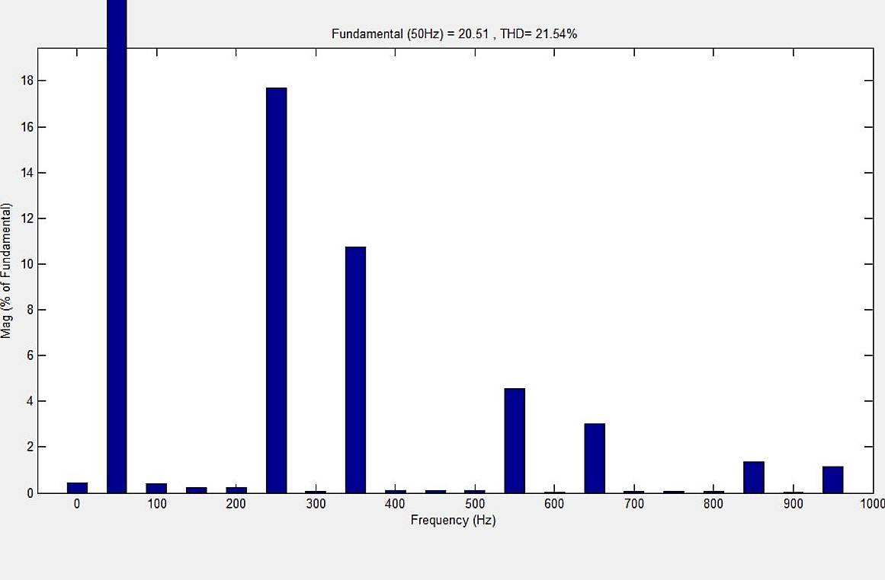
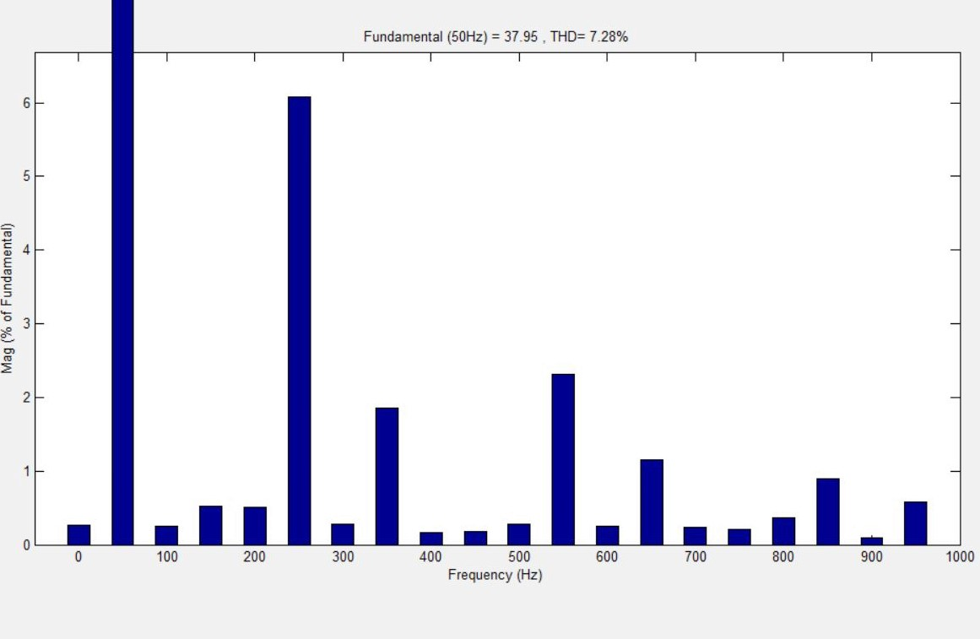
Result
FFT Un-Compensated
FFT Compensated
Fundamental(50Hz) = 20.51
THD= 21.54%
Fundamental(50Hz) = 37.95
THD= 7.28%

Slide 6
Result
FFT ANALYSIS | POWER FACTOR
BEFORE COMPENSATION
A | B | C
21.55% | 21.70% | 21.53%
A | B | B
0.7871 | 0.6387 | 0.6873
AFTER COMPENSATION
A | B | C
7.27% | 7.36% | 6.87%
A | B | C
0.9201 | 0.8517 | 0.8966

Slide 7
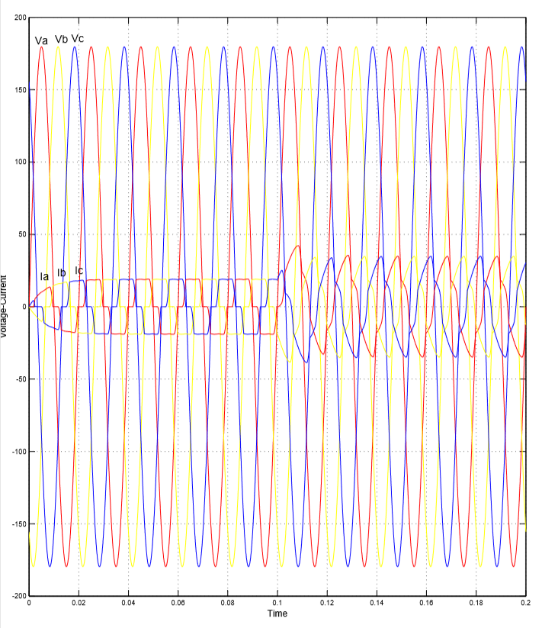
VI Measurement
Un-Compensated

Slide 8
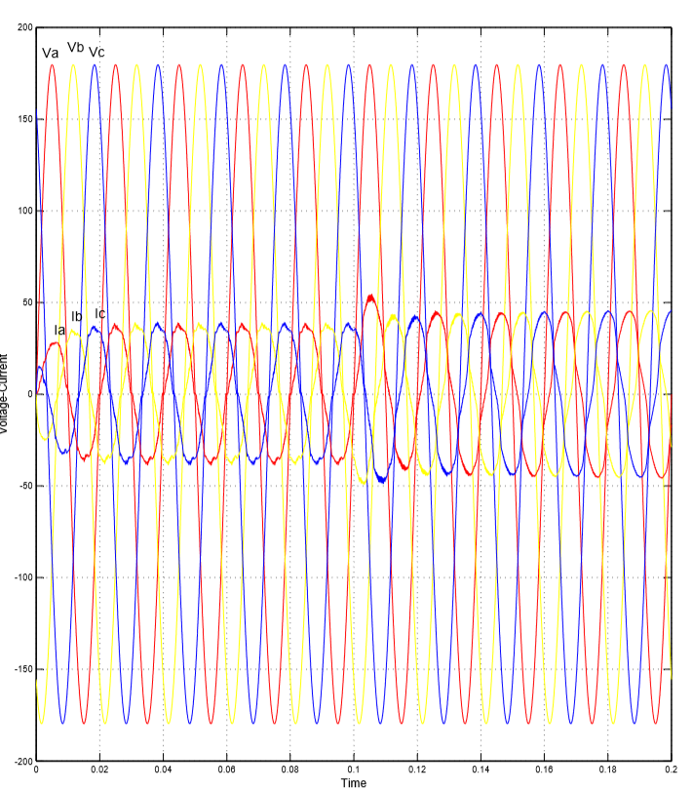
Compensated

Slide 9
Conclusion

Slide 10
References
The Direct Current Control Method of STATCOM and its simulation.2013 Third International Conference on Intelligent System Design and Engineering Applications.
Nagrani G. Hingorani , Laszio Gyugyi. Understanding of FACTS Concepts and Technology of Flexible AC Transmission System . IEEE Press 1999.
Using STATCOM Interfacing of Renewable Energy Sources to Grid and Power Quality Improvement. 2015 International Conference on Energy System and Applications.
P.S. Bhimra , Power Electronics.
Improvement of Voltage Quality in AC Network by use of STATCOM -2005Mazurov M.I.,Nikolaev A.V.,Lozinova N.G

